Slide 1
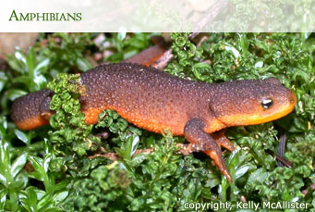
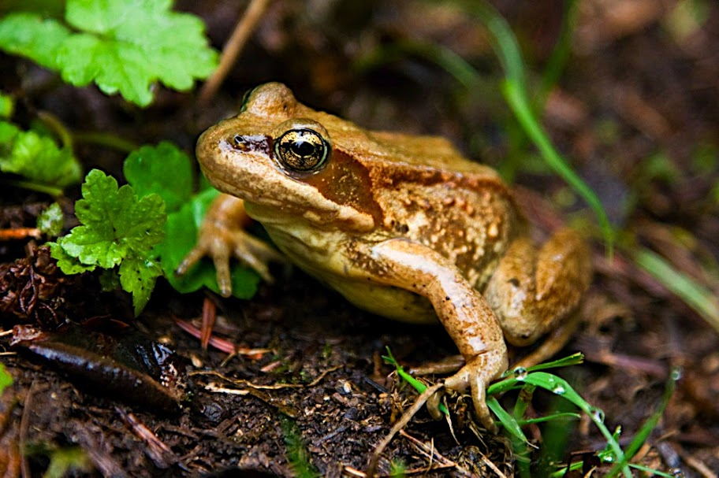
Lab 10 Climate and the Biosphere
Amphibians on the Move: Predicting Why and When

Slide 2
Housekeeping
This week
Please fill out course evals! ---- before lab ends today
Lab 10 pre-lab
Next week
FINAL EXAM
Monday, June 10th, 8 PM, JOHN 102

Slide 3


Slide 4

Student Learning Experience Survey
The Student Learning Experience survey (SLE) offers students and instructors the opportunity to work together to improve the quality of teaching at OSU.
Scan the QR code with your phone. Login to the SLE using your OSU ONID credentials.
The first 5 weeks of the lecture was taught by Dr. John Fowler. The second 5 weeks of the lecture was taught by Dr. Carmen Harjoe. Your lab teacher was me, Giovanni A. Crestani.
Thank you for helping us improve our course and our teaching!

Slide 5
Lab Objectives
1. Predict amphibian migration events using climate data and knowledge of amphibian behavior;
2. Use amphibian sighting data to evaluate predictions for accuracy and to identify environmental variables that cue amphibian migration events;
3. Create and analyze graphs in order to identify relationships between amphibian migration, latitude and temperature;
4. Describe potential applications of amphibian sighting data to scientific research on climate change and amphibian conservation efforts.
5. Use a Geographic Information System program to model species habitat range.
6. Model the impacts of different global climate change scenarios on species habitat range.

Slide 6
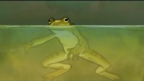
Why are frogs disappearing?
Notes:
Disappearing frogs - Kerry M. Kriger – YouTube
https://www.youtube.com/watch?v=NvP6j4Dj0VA

Slide 7
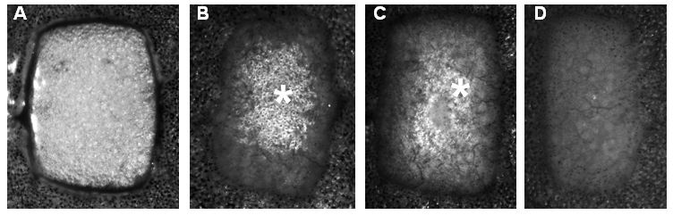
The Wide World of Science!
Thomas Craft Sr.
1924 - 2022
Black scientist and WWII veteran
He researched skin grafting and the protective qualities of melanin
Sometimes the body can reject its own skin graft
Amphibians have sensitive skin that can be helpful for dermatological investigation
By experimenting with amphibians, Dr. Craft learned that increases in stress hormones is correlated with skin graft rejection
After he retired from American University, he spent time volunteering to improve educational opportunites for Black students studying STEM
Light colored cells indicating graft acceptance in amphibian. As the study goes on, the graft is rejected.
Notes:
Notes from slide
African American scientist and WWII veteran
He researched skin grafting
Sometimes the body can reject its own skin graft
Amphibians have sensitive skin that can be helpful for dermatological investigation
By experimenting with amphibians, Craft learned that increases in stress hormones is correlated with skin graft rejection
After his time at American University, he began developing degree programs to encourage underrepresented students to study STEM
Additional Notes
Was drafted in WW2 as a marine
Skin grafts: skin taken from one part of the body can be used to patch other other areas of the body where the skin has been damaged
The new skin needs to attach to the underlying cells
Sometimes the body will reject its own skin graft
He used amphibians to test why the grafts were being rejected
Amphibians have very sensitive skin
There was a correlation between the release of hormones and the rejection of a skin graft (when stress increases, graft acceptance decreases)
He was later appointed to the advisory board of NIH, NSF, and the Ohio state government
He worked on designing undergraduate programs to encourage underrepresented students in STEM
He also studied melanin and its protective qualities for skin
(interesting tidbit, but not directly related to Thomas Craft Sr.) In the earlier days of skin graft experimentation, frogs were sometimes directly grafted onto the skin and left for several days to encourage the graft. Most, if not all of these experiments failed.
Sources
Spangenburg, R., Moser, D., & Long, D. (2014). African Americans in science, math, and invention. Infobase Publishing. pp 50-52
Ozhathil, D. K., Tay, M. W., Wolf, S. E., & Branski, L. K. (2021). A Narrative Review of the History of Skin Grafting in Burn Care. Medicina, 57(4), 380.
Kessler, J. H., Morin, K. A., Kidd, J. S., & Kidd, R. A. (1996). Distinguished African American scientists of the 20th century. Greenwood Publishing Group.
Image: https://www.intechopen.com/books/skin-grafts-indications-applications-and-current-research/comparative-study-of-skin-graft-tolerance-and-rejection-in-the-frog-xenopus-laevis

Slide 8
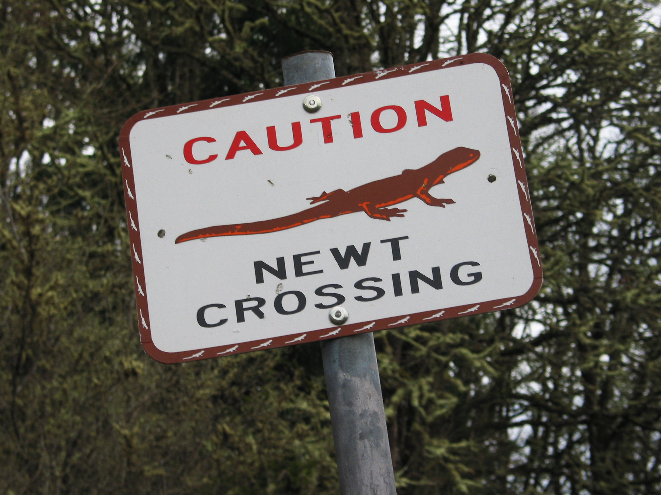
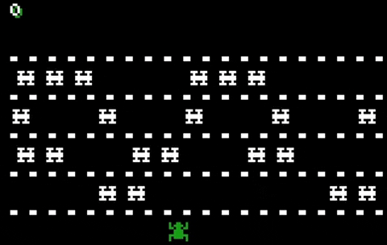
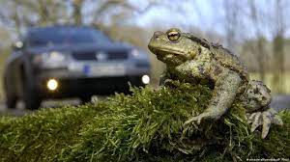
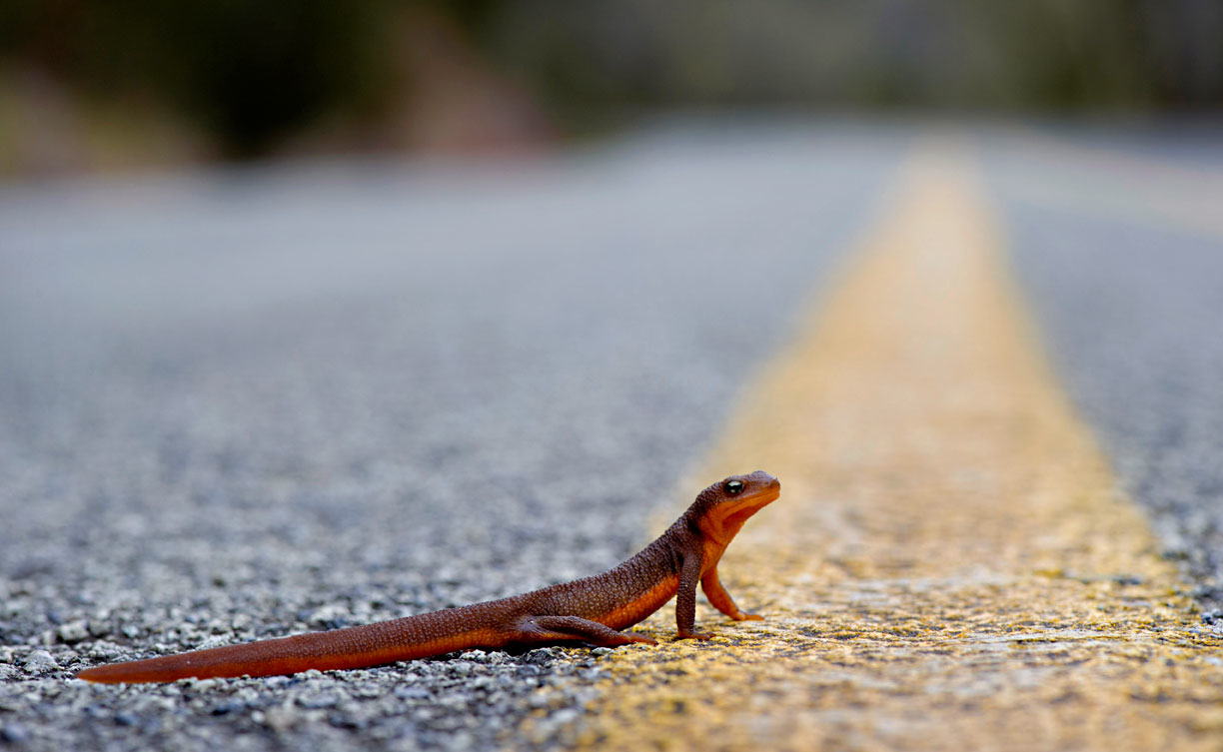
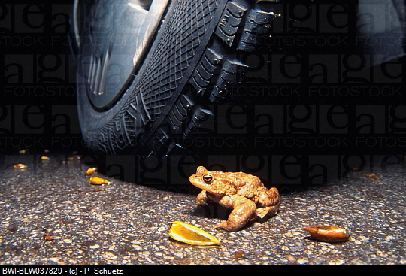
Amphibian Migration and Road Mortality
Notes:
Play video on amphibian migration and road mortality https://www.youtube.com/watch?v=jeLY_QcUIZY

Slide 9

Management strategies: what should we do?
Notes:
Volunteer?, design and retrofit roadways to be wildlife friendly? Predict migration and use volunteers? Ask for volunteers to explain their plan

Slide 10
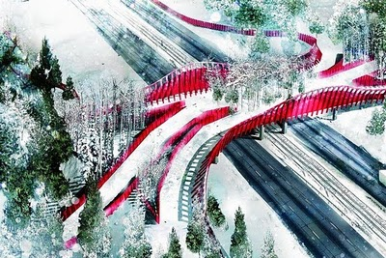
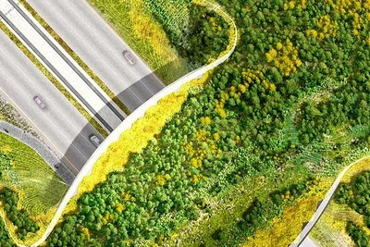
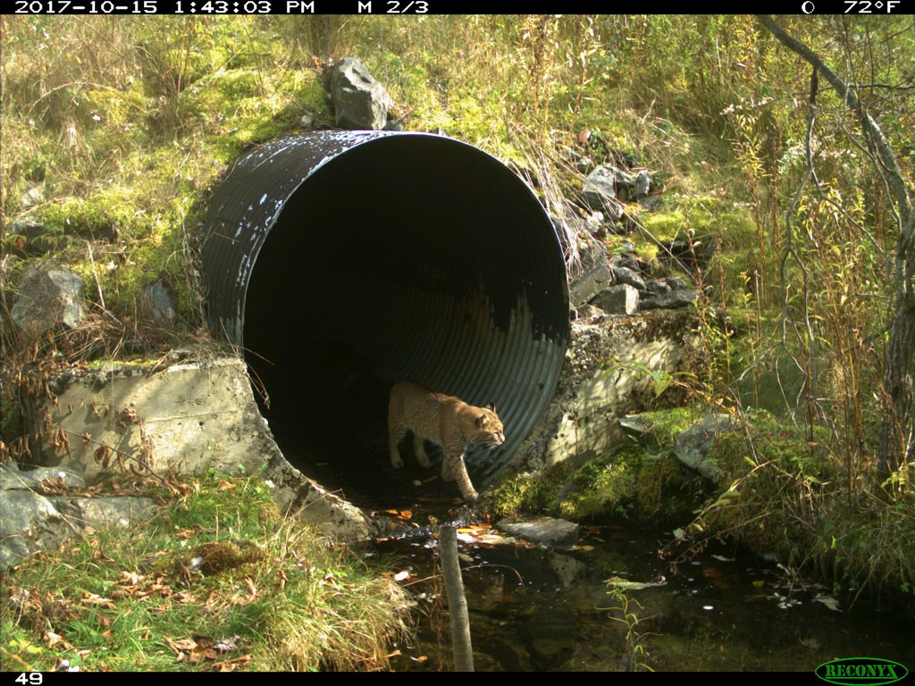
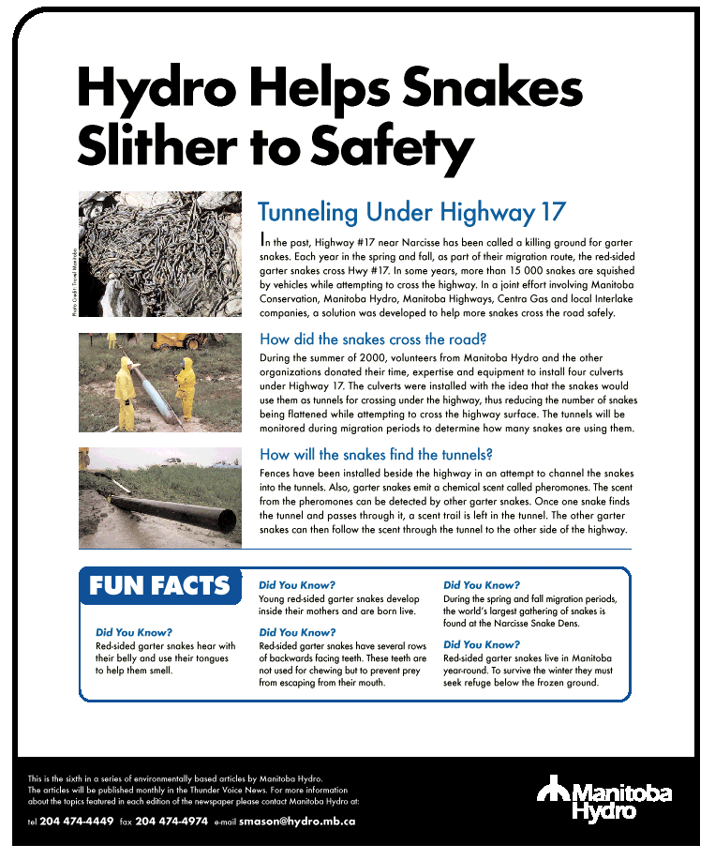
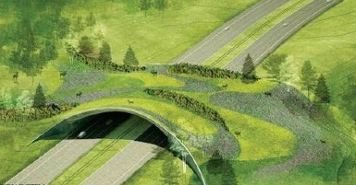
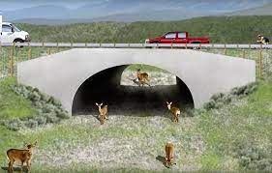
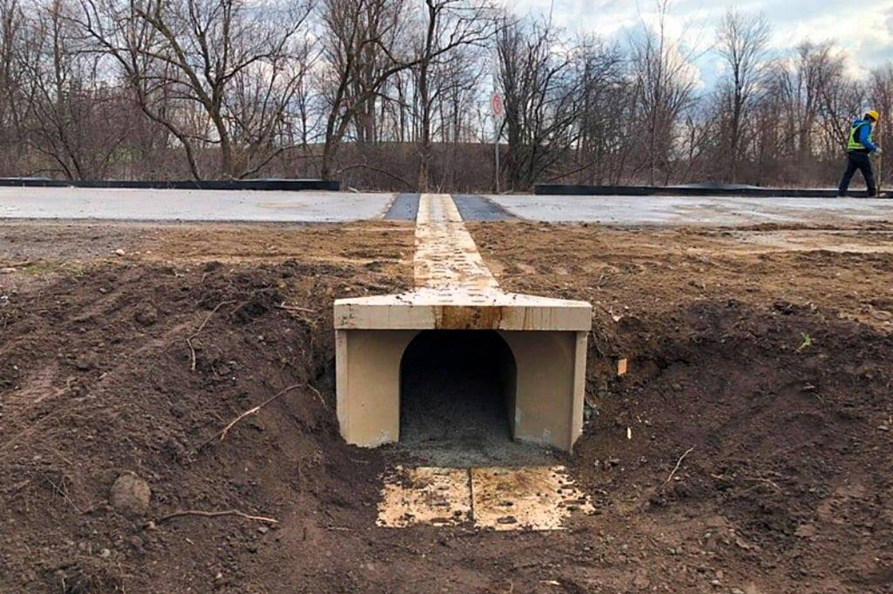
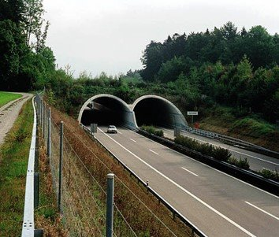
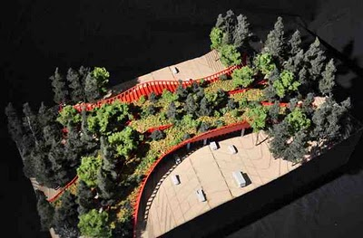
Wildlife-Friendly Roadways
Notes:
Here are a few examples of bridges and tunnels that are meant to limit road mortality.

Slide 11
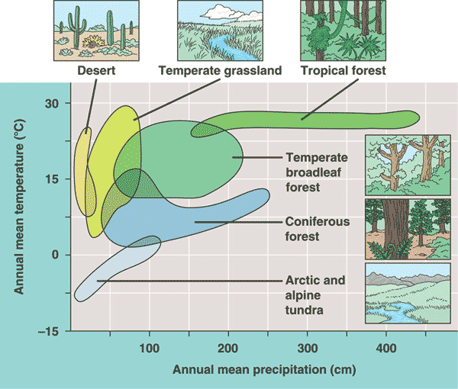
Climate and the Biosphere
Many organisms move between habitats
Many use different areas for breeding
Climate limits the distribution of organisms.
Climographs – plots mean temp and precipitation
Other factors also play a role – such as pattern of climate (wet/dry seasons, etc.)

Slide 12
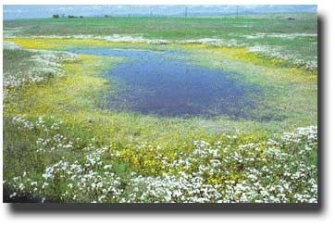
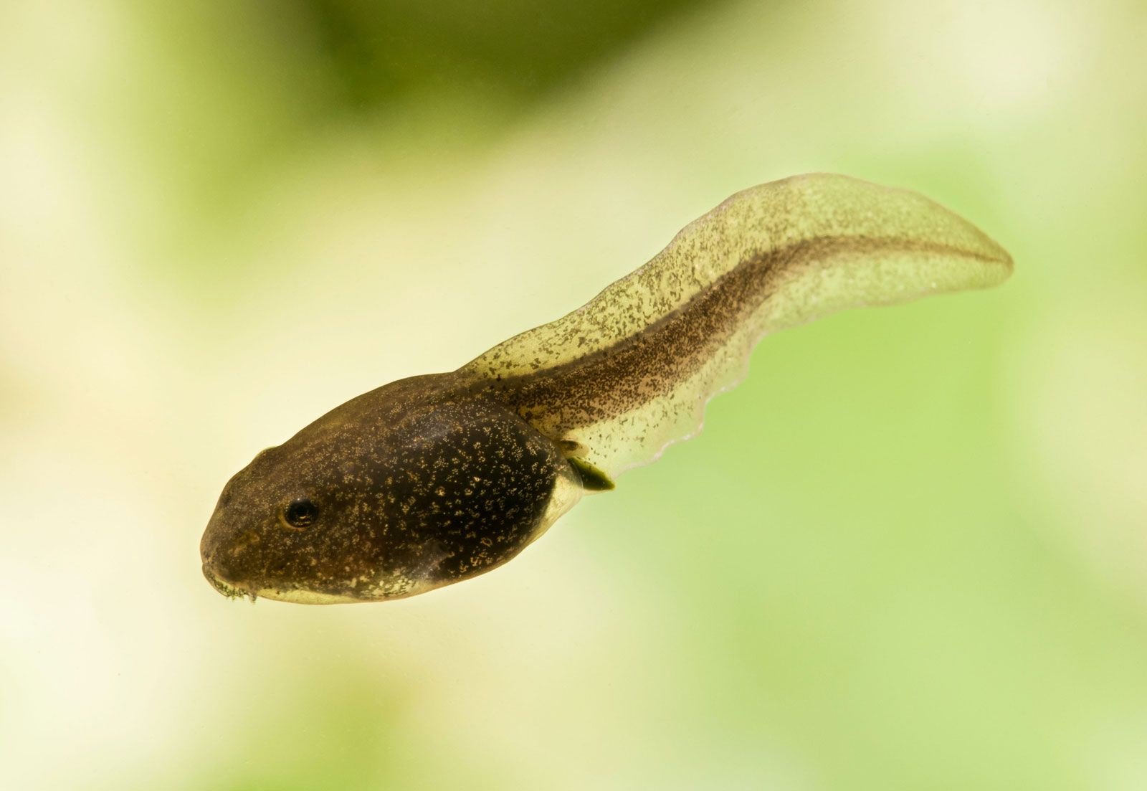
Aquatic Biomes
Freshwater biomes are closely linked to soils and biotic components of surrounding terrestrial biomes.
Vernal pools, also called ephemeral pools, are a special wetland habitat devoid of fish.
Many amphibians move between vernal pools (breeding) and forest (foraging)
What about amphibians makes migration to vernal pools necessary?

Slide 13
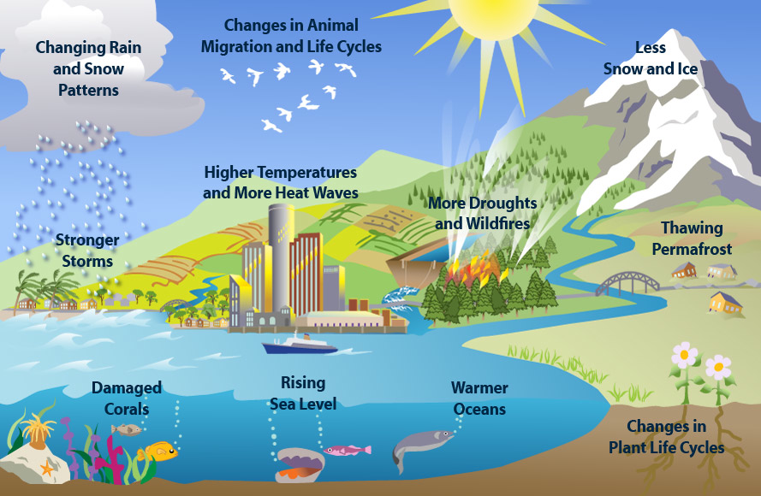
Climate Change and Human Impact
Impacts on habitat:
Terrestrial biome
Anthropogenic biome
Climate change

Slide 14
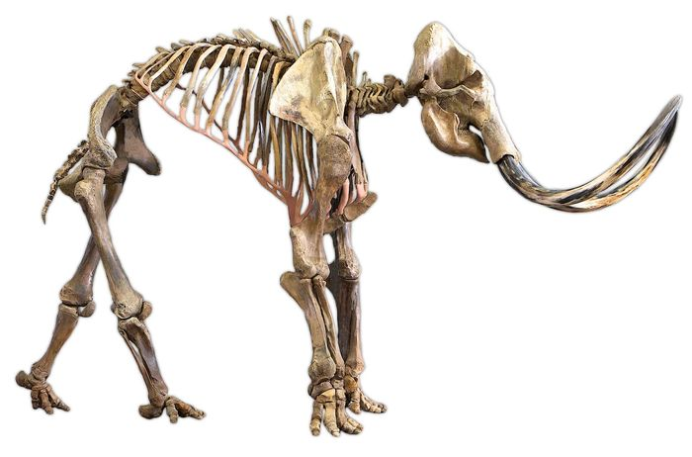
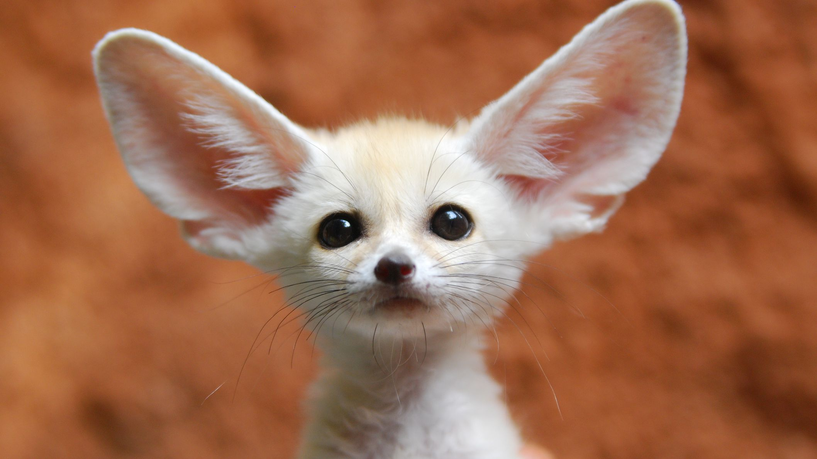
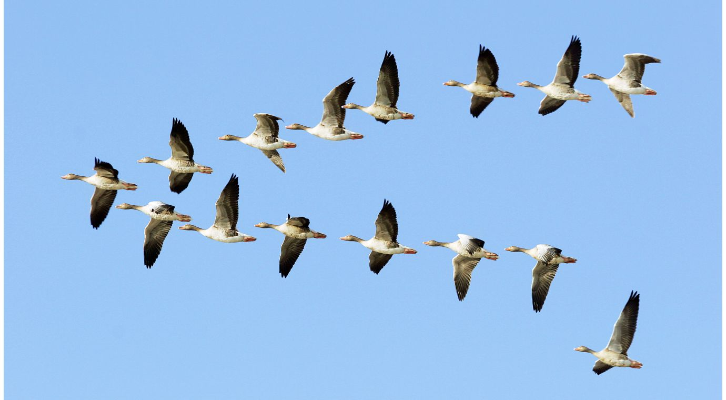
How Do Species Respond to Change?
Adapt
Move
Die

Slide 15
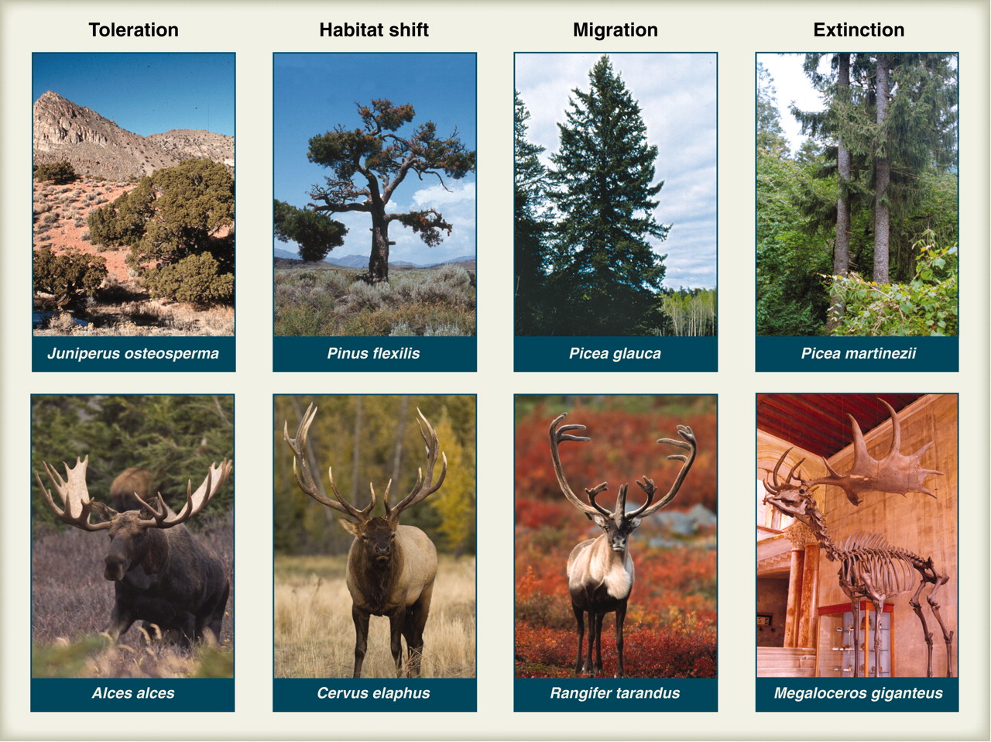
How will species adapt (or not)?
Researchers are determining species’ current ranges to predict how they will change.
Species’ ability to move to appropriate habitats will be limited depending on the anthropogenic biome: roads, urban areas, and other barriers.
Environmental changes cause pop. Bottlenecks, reducing genetic diversity

Slide 16
How will species adapt (or not)?
Many species respond by seasonal migration, often for mating.
Frogs tend to migrate when the temperature is above freezing (40F), snow has melted, and rain has begun.
Environmental changes cause pop. Bottlenecks, reducing genetic diversity

Slide 17
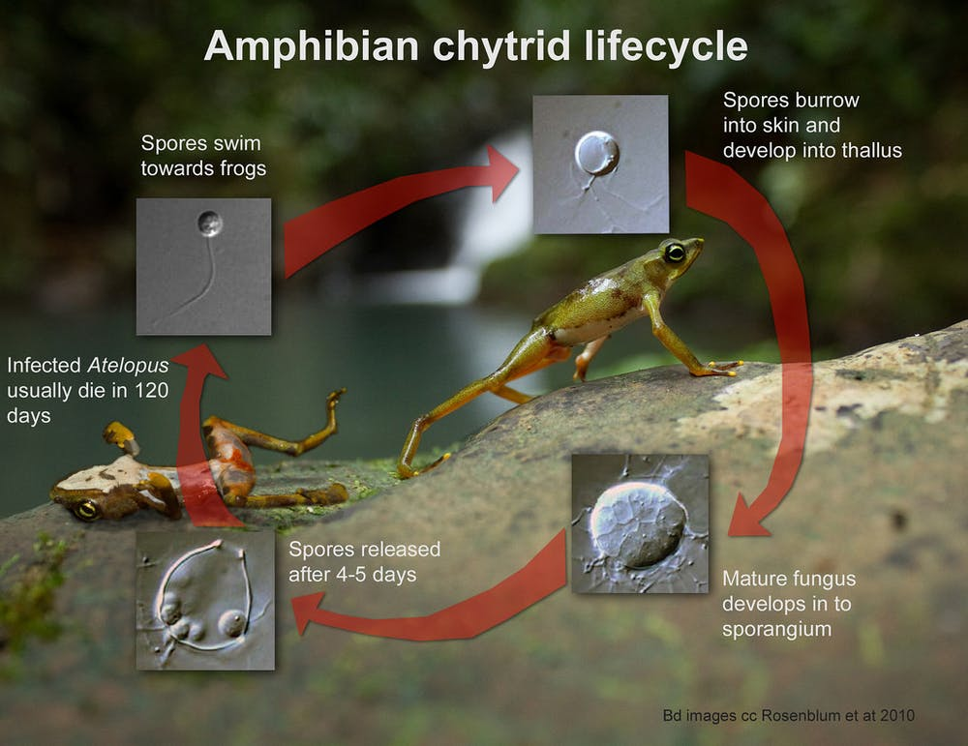
How will species adapt (or not)?
Climate change may also increase susceptibility to other stressors:
Amphibian chytrid fungus,
Batrachochytrium dendrobatids

Slide 18
DIVA-GIS (Geographical Info System) Modeling Envelope Construction
Population localities
Superimpose climate
Read limits from localities within climate bounds
Rate Area
Not-suitable to Excellent
Based on percentiles
Use climate bounds to predict future population bounds

Slide 19
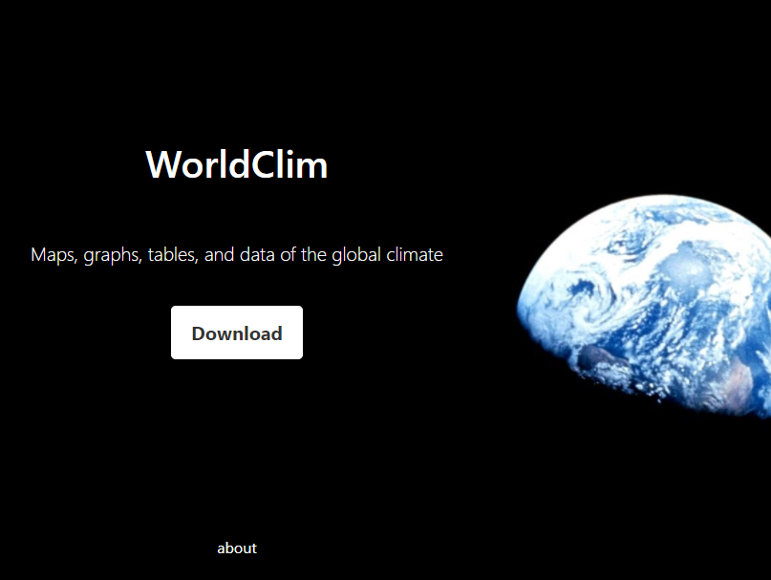
Using DIVA-GIS: Data Sources
Basic climate data included with DIVA-GIS – On desktop
Download layers – lab materials module on canvas > Google Drive
Accumulation of worldwide climate data sets
Animal locality data downloaded from VertNet – Pick animal and download
Choose a terrestrial vertebrate, (no whales, fish, etc). I prepared some datasets and made them available on Canvas.

Slide 20
Lab Mechanics
Part 1 – Amphibians on the Move: Predicting Why and When
Part 2 - Using GIS to Project species distributions under different climate scenarios
Part 3 – Global Climate Change, Amphibians and Conservation
Part 4 - Scientific Ideas and Modern Society
Notes:
This lab only has two check offs, after part 1 and after part 4

Slide 21
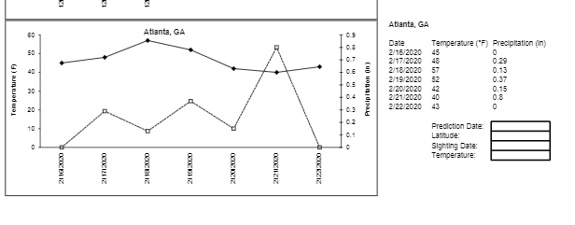
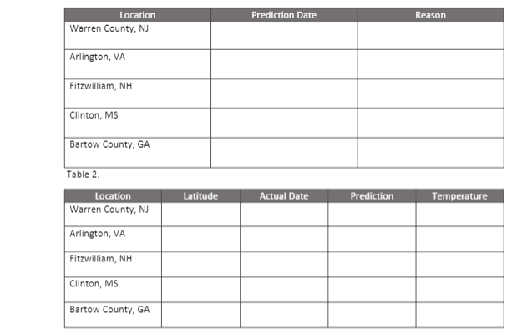
Part I: Amphibians on the Move
Pg 123
Predict when frogs will migrate at each location from excel workbook information and background reading.
Find latitude data from latitude finder for table.
Look up and record amphibian sighting date for table 2, on amphibian tracker map (2020).
Was temperature or precipitation the highest value on the actual siting day?
Record this on table 2.
Graph latitude by siting date
2/19
Precipitation
Notes:
Some students like more detailed instructions for the lab in the powerpoint, so this is for them!
One thing I noticed was that the species in the worksheet up here did not match the species locations in the table? Maybe they can guestimate from nearby counties?

Slide 22
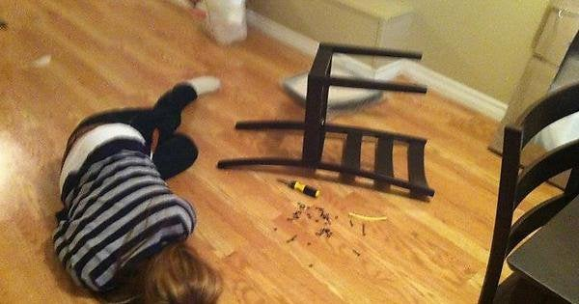
Part II: Modeling Species Habitat
Pg 128
YOU NEED TO READ EVERY STEP OR YOU WILL BE VERY SAD AND FRUSTRATED!

Slide 23
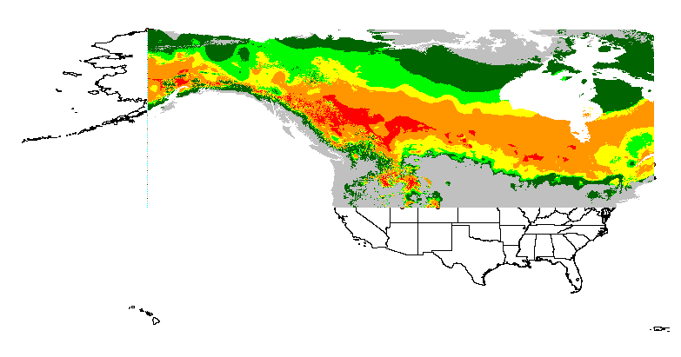
Part II: Modeling Species Habitat
Pg 128
Follow along with the DIVA GIS Instructions carefully
Search and download data on where your favorite animal was spotted through “vertnet” (link in canvas).
Save only lat and long data.
Upload into GIS and apply map.

Slide 24
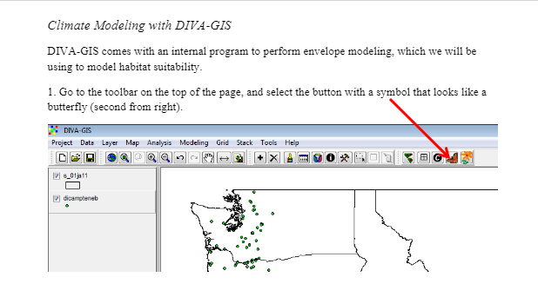
Part II: Modeling Species Habitat
Pg 128
Follow along with the DIVA GIS Instructions carefully
Apply climate data from the GISzip folder to your map.
Alter the climate by clicking “change climate” by +1, +2, +3 degrees and compare habitable ranges.
Keep your maps open for signature questions.

Slide 25
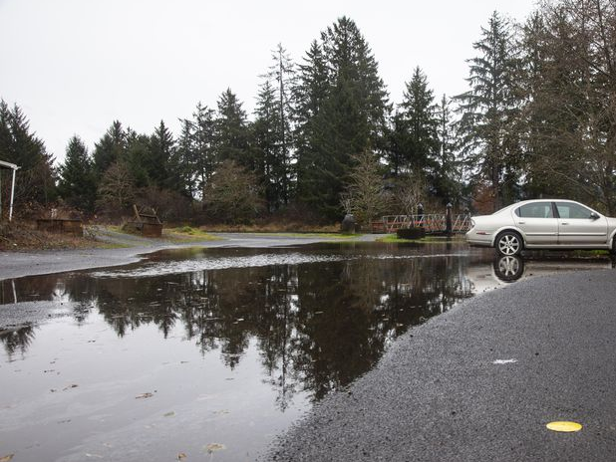
Part III and IV: Climate change in Oregon
Pg 139
Part 3
Revisit topics from intro and answer worksheet questions
Part 4
Understand the impacts of Climate Change here in Oregon, and what we can expect moving forward
The photo is a king tide in Oregon, mimicking higher sea levels
Notes:
Climate change in Oregon by the numbers, from 0.1 to 200 – OPB
The photo is a king tide in Oregon, mimicking higher sea levels

Slide 26

Questions?

Slide 27
Today’s roadmap and tips:
Part 1: Climate change and migration
Download GIS zip folder and extract files before starting
pg126, Q12: The graph will automatically generate. Ignore this step!
Part 2: Using GIS to model habitat under different climates
BE PATIENT. Don’t click anything after “apply” until the map regenerates
Save all files to downloads, not shared drive (bootcamp)
pg131, Q5: Close excel file before uploading to GIS.
pg137. Q13: Reorder map by right clicking on the data points and click “move to top”
pg138. Q7: Go to input and change “worldclim_2-5m” to “wc_cmm3_2-5m”
Log off computers.

